Slide 1

AWS Lambda
Serverless Computing in AWS
Cloud Architecture & DevOps | March 2026

Slide 2



INTRODUCTION TO AWS LAMBDA
Fundamental Compute
Operational Focus
AWS Lambda is a serverless, event-driven compute service that lets you run code for virtually any application or backend.
It eliminates infrastructure management tasks like server provisioning, patching, and capacity scaling for developers.

Slide 3

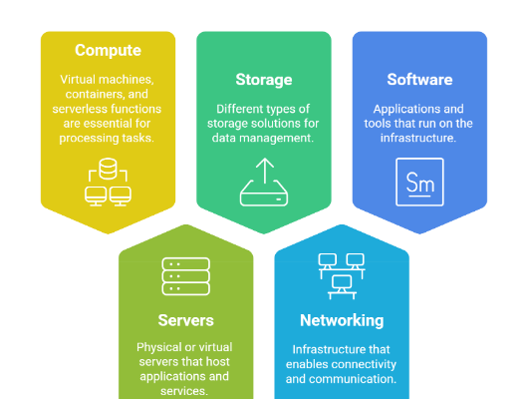
WHAT IS SERVERLESS?
No server management required by the user
Automatic scaling based on workload volume
Built-in high availability and fault tolerance
Pay only for what you use (No idle costs)

Slide 4





KEY FEATURES OF AWS LAMBDA
No Management
Auto-Scaling
Zero servers to provision or patch manually.
Scales from 1 to thousands of requests instantly.
Pay-per-Use
Event-Driven
Charged based on requests and execution time.
Trigger code automatically from other AWS services.

Slide 5
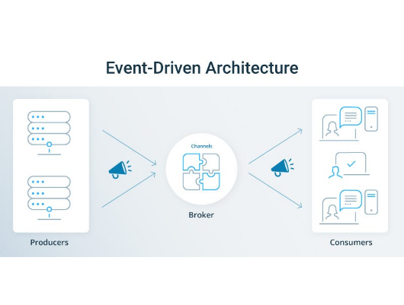
HOW AWS LAMBDA WORKS
Upload: Put your code in the Lambda console.
Trigger: Set up an event source (e.g., S3 upload).
Execute: Lambda runs code when the event occurs.
Response: Results are returned or sent to output.

Slide 6
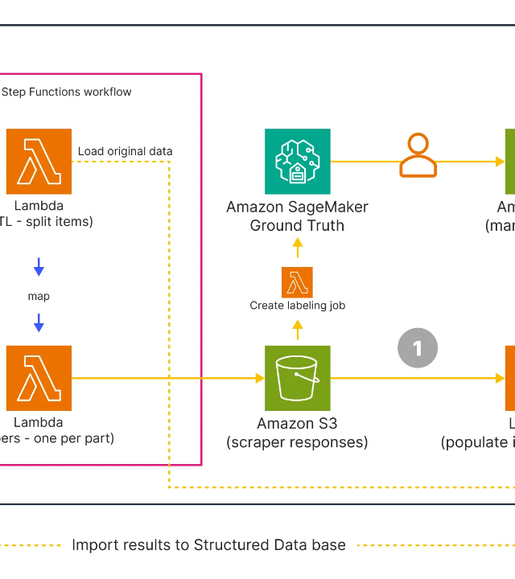
SYSTEM ARCHITECTURE
Event Sources: The 'Triggers' that start it.
Lambda Function: Your logic and runtime.
Environment: Isolated execution container.
Downstream: Database or API output.

Slide 7
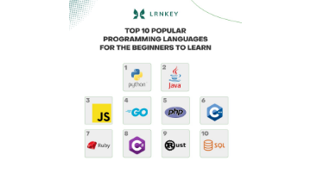

SUPPORTED PROGRAMMING LANGUAGES
Python & Node.js
Java & C# (.NET)
Go & Ruby
*Custom runtimes (Rust, PHP, etc.) are supported via Lambda Layers.

Slide 8
EVENT SOURCES & TRIGGERS
Service | Event Type | Typical Action
Amazon S3 | Object Created/Deleted | Image Resizing, Data Load
API Gateway | HTTP Request | Web Application Backend
CloudWatch | Scheduled Event | Periodic Cron Jobs
DynamoDB | Table Updates | Data Transformation

Slide 9

INTEGRATION WITH AWS SERVICES
Seamlessly connects to S3 for automated file processing.
Direct integration with DynamoDB for data validation.
Acts as the logic layer for API Gateway REST APIs.
Integrated monitoring with Amazon CloudWatch logs.

Slide 10
ADVANTAGES OF AWS LAMBDA
No Infrastructure Management: Focus purely on code.
Hyper Scalability: Scales horizontally automatically.
Cost Efficient: Sub-second billing saves money.
Resilient: Multi-AZ deployment out of the box.
Rapid Deployment: Go from code to production in seconds.

Slide 11


LIMITATIONS & DISADVANTAGES
Technical Constraints
Performance Factors
15-minute maximum execution time and limited local disk space (512MB to 10GB).
Latency issues ("Cold Starts") when functions are invoked after inactivity.
*Not recommended for long-running batch processing or real-time high-performance gaming.

Slide 12
AWS LAMBDA PRICING MODEL
1M
Free Requests per Month
The free tier never expires, making it perfect for small projects and low-traffic apps.
Requests: $0.20 per 1 million requests after free tier.
Duration: Cost depends on memory allocated and execution time.
Architecture: Graviton2 (ARM) offers up to 20% lower cost.

Slide 13



REAL-WORLD USE CASES
Media Processing
Mobile Backends
Automated thumbnail generation for streaming platforms.
Processing user authentication and database queries.
Chatbots
Data Sync
Handling conversational logic for support bots.
Syncing records between CRM and internal databases.

Slide 14
BEST PRACTICES FOR LAMBDA
Keep functions small and focused (Single Responsibility).
Optimize memory allocation to balance performance and cost.
Use IAM Roles to grant minimal required permissions.
Implement comprehensive logging and monitoring with CloudWatch.
Externalize configuration using Environment Variables.

Slide 15
The Future is Serverless
AWS Lambda is transforming how we build modern cloud architectures by making infrastructure invisible and allowing developers to focus purely on innovation.

Slide 16





IMAGE SOURCES
https://uptimerobot.com/knowledge-hub/wp-content/uploads/2025/02/cloud-infrastructure-components.png
Source: uptimerobot.com
https://miro.medium.com/0*k9vCsZDxVn27YWV0.jpg
Source: medium.com
https://images.ctfassets.net/w6r2i5d8q73s/1mdrT2mU09TpfTPZSEr9v2/585f7580282ed25b57d015c9a10ffa18/4.png?fm=webp&q=75
Source: miro.com
https://lrnkey.com/storage/filemanger_uploads/Programming_coding/popular-programming-languages-lrnkey.jpg
Source: lrnkey.com
https://media2.dev.to/dynamic/image/width=1000,height=420,fit=cover,gravity=auto,format=auto/https%3A%2F%2Fdev-to-uploads.s3.amazonaws.com%2Fuploads%2Farticles%2F2ghx88b7suq0zrvxiar3.jpg
Source: dev.to

